Slide 1
Pinhole Projection
NB. Assume students have completed a unit dealing with shadows. They know that light propagates in straight lines.
Levels of Inquiry

Slide 2
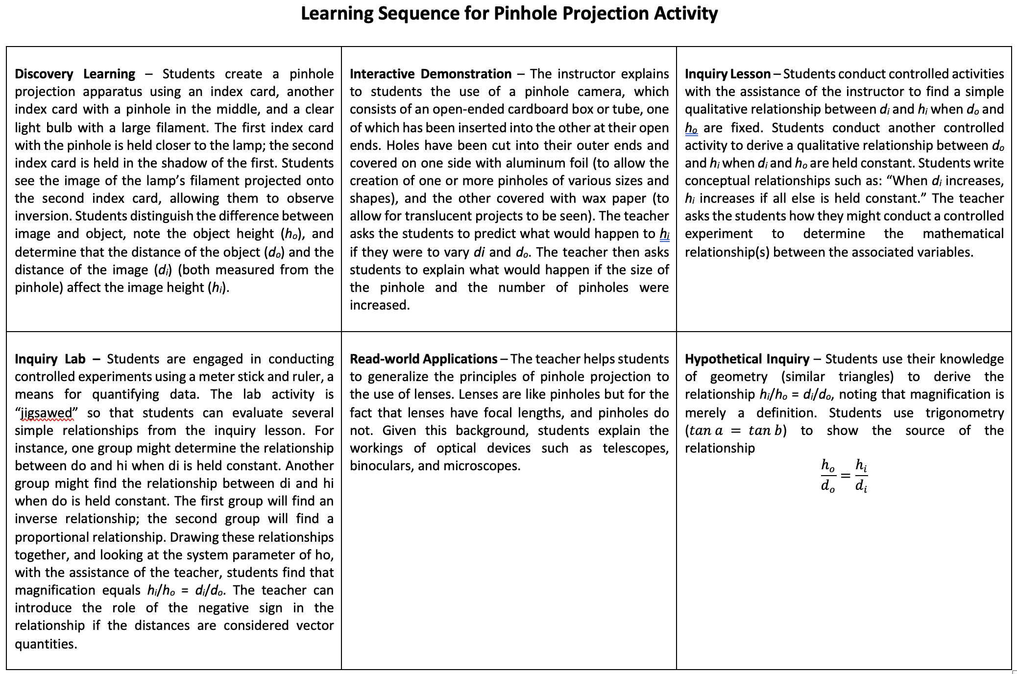

Slide 3
Discovery Learning

Slide 4
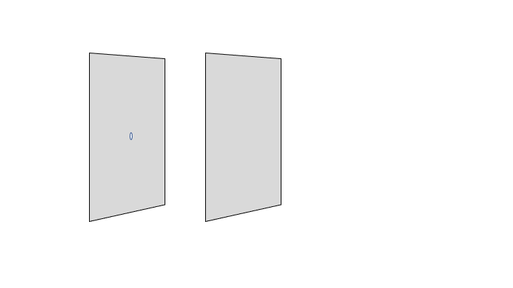
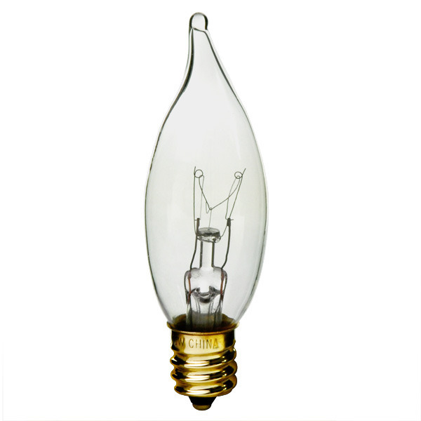
Index cards. Note that the one closest to light bulbs has a pinhole.

Slide 5
Questions
What do you see?
How many pinholes and how many images?
How clear are your images?
How bright are your images?
How big are your images?
What can you do to make images bigger or smaller?
Do your images have the same “arrangement” as the objects?

Slide 6
Interactive Demonstration

Slide 7
Pinhole Camera
aluminum foil
light source
(wax paper)
adjustable “slide”

Slide 8
Light source Box front Box rear
Object Pinhole Screen

Slide 9
Linear filament

Slide 10
Rectangular filament

Slide 11
Using the pinhole camera, see what you can find out about producing images of light bulbs.
You may modify the camera in the following ways:
Larger/smaller pinhole
Multiple pinholes
Move it toward and away from the light bulb.
Carefully compare the image to the object.
How are they the same?
How are they different?

Slide 12
Using the pinhole camera, see what you can find out about producing images of light bulbs.
Finding 1: The pinhole produces an image of the object.
Finding 2: The bigger the pinhole, the brighter the image.
Finding 3: The bigger the pinhole, the fuzzier the image.
Finding 4: The number of pinholes = the number of images.
Finding 5: The pinholes produce up-side-down images.
Finding 6: The pinhole produces an inverted image.
Finding 7: The pinole nearer the lamp produces a brighter
image and vice versa.
Representative Findings

Slide 13
Inquiry Lesson

Slide 14
http://www.whiteboardsusa.com/whiteboarding_flier.pdf

Slide 15
Without measuring devices, find as many qualitative relationships between variables as possible.
Result:
Shorthand:
As X goes up, Y goes up
As R goes down, S goes down.
If X $↑$, then Y $↓$
If R $↓$, then S $↓$
NB. Teachers should keep a record of these findings. These qualitative relationships will
be used later as the basis for finding quantitative relationships between two variables.

Slide 16
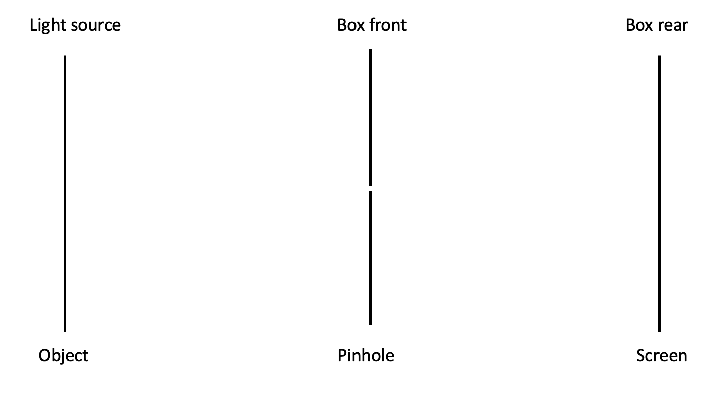
How do pinholes produce images? (small groups!)

Slide 18
Time for a two-page Modeling Method worksheet! Whiteboard and review; see flier. We will use breakout rooms to jigsaw the work. BO Group 1 page 1; BO Group 2 page 2.
http://www.phy.ilstu.edu/~cjwennin/310content/pinhole_worksheet.pdf

Slide 19
Does your image formation model accurately explain what you have observed?
Complete worksheet from Modeling Method of Physics Instruction.

Slide 20
Inquiry Lab

Slide 21
Moving ahead - Definition of terms:
Object distance (from pinhole)
Image distance (from pinhole)
Object height (physical size)
Image height (as measured on screen)

Slide 22
Light source Box front Box rear
$$d_{o}$$
$$d_{i}$$
Object Pinhole Screen

Slide 23
Light source Box front Box rear
$$d_{o}$$
$$d_{i}$$
$$h_{o}$$
$$h_{i}$$
Object Pinhole Screen

Slide 24
A word about “meatball” physics.

Slide 25
Can we find a detailed relationship between variables using controlled experiments and measurements?
Assign “jigsaw teams.”
Each team finds a mathematical relationship between two variables based on prior principles using a controlled experiment.
Be certain to measure your system’s parameters (e.g., two variables that are not you independent and dependent variables.)
Make a graph independent vs. dependent variable to find the mathematical relationship.
Whiteboard and report out at end of time-limited work period.
Relate system parameters to any constants.

Slide 26
Based on qualitative relationships, find a quantitative relationship between two given variables using measurement and graphs. Assume that $ho$ is constant; conduct a controlled experiment.
Prior qualitative findings:
For a fixed $di$, as $do$ $↑$, $hi$ $↓$and vice versa.
For a fixed $do$, as $hi$ $↑$, $di$ $↑$and vice versa.
For a fixed $hi$, as $di$ $↑$, $do$ $↑$and vice versa.

Slide 27
Representative Individual Finding
Equation
Parameter
$$h_{i}=5cm\frac{d_{i}}{d_{o}}$$
$$h_{o}=5cm$$
Conclusion
$$\frac{h_{o}}{d_{o}}=\frac{h_{i}}{d_{i}}$$

Slide 28
Group Conclusion
$$\frac{h_{o}}{d_{o}}=\frac{h_{i}}{d_{i}}$$

Slide 29
Real-world Applications

Slide 30
Real-world Applications
Using the formula found, if $hi = x$, $ho = y$, and $di = z$, what is $do$?
If magnification, $m$, is taken as the ratio of $hi$ to $ho$, what magnification does $di = x$and $do = y$yield?
A refracting telescope has a focal distance 0.9m. A 10-m-tall tree is located 300m away from the objective lens. What is the size of the image of the tree on the CCD of a DSLR camera if the focal plane of a camera is coincident with the focal plane of the telescope?

Slide 31
Hypothetical Inquiry

Slide 32
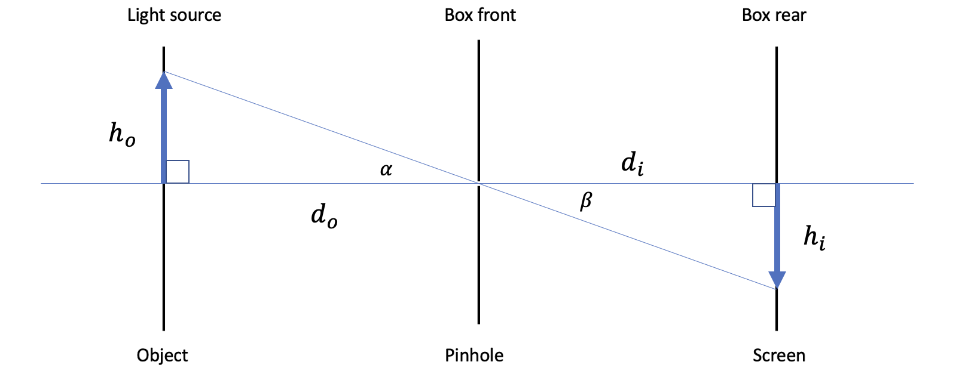
Use geometry or trig to derive empirical formula.
Geometry
Trigonometry
Similar triangles
The ratios of corresponding sides are also equal.
$$\tan{α}=\tan{β}$$
$${\left(\frac{opp}{adj}\right)}_{left}={\left(\frac{opp}{adj}\right)}_{right}$$

